Slide 1
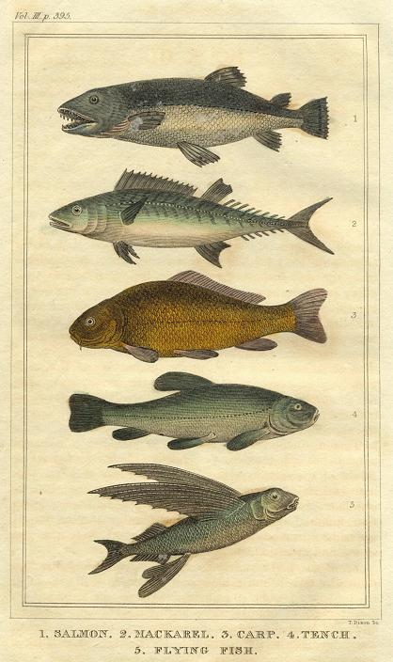
Bound for South Australia 1836 Fishing Week 11
1.Salmon 2.Mackarel. 3.Carp 4.Tench 5.Flying Fish" engraved by T.Dixon, published in Oliver Goldsmith's History of the Earth and Animated Nature', 1822.

Slide 2
Overview
Between February and July 1836 nine ships left Britain bound for the newly created province of South Australia. On-board the ships were passengers who over many long months braved the perils of the ocean, including some of the most treacherous seas in the world to begin a new life on the other side of the world.
This resource uses the stories from these nine ships as recorded by the passengers and crew in their personal journals.

Slide 3
Contents
Introduction
Journal entries
Inquiry Questions
Relevant images
Glossary of terms

Slide 4
Introduction
We read in the John Pirie journal this week about the sighting of flying fish and a shark. The crew were keen to catch the shark, but were unsuccessful, as the captain throws the bait overboard without a line attached. The men made fun of this event, causing a ‘hearty laugh’ amongst them. The shark’s life was spared this time.
The world’s oceans cover 71% of the earth’s surface and are an ecosystem made up of plant and animal life, ranging from the whales, sharks and other large predators at the top of the food chain to the smallest forms of life in coral and plankton. The balance of life within this ecosystem is dependent on a number of factors, including water temperature, climate change and human actions. Since 1836, the world’s population has increased significantly and the fragile ocean ecosystem has been affected by the advances in technology and actions of people across the globe.

Slide 5
Journal entries Thursday 5 May 1836
Captain Robert Morgan, on board the Duke of York wrote:
This 24 light airs and calms all sail set thundering and lightning at times employd fitting Whaleing guier saw a strange sail had a man at the mast head for the first time looking for Whales Lattd Obsd 4.30 N Long^{d} by chro 21.20 West ….

Slide 6
Friday 6 May 1836
Captain Robert Morgan, on board the Duke of York wrote:
This 24 hours light airs and calms with all draw ing sail set employd as needfull a look out for Whales saw none Latt^{d} Obs^{d} 4.00 N Long^{d} 20.54 West ….

Slide 7
Saturday 7 May 1836
John Pirie journal writer, on board the John Pirie wrote:
There has been a fresh Breeze all Night from E,N,E, and at 8, A,M, took a reef in the Fore-top Sail , for the first time since leaving Dartmouth, and at 11, A,M, had the Islands of Brava and Fogo, (two of the Cape Verde) right abeam of us, the former about 20, and the latter 40 Miles distant, on the larboard Side, it then fell Without wind. Calm , and remain’d so untill the Even^{g}, during which, the heat was excessive ____ We saw a great number of flying Fish , this Morng and in the Afternoon were follow’d by a Shark, that broke two fishing Lines, and a strong Hook, when One of the Sailors found a proper Shark-hook, on to which he put a piece of Pork, for Bait, and gave it to the Capt , who in his eagerness to catch the Fish, did not notice, that there was no Line made fast to it, but immediately threw it overboard, which caused a hearty Laugh, and most probably saved the Sharks life, for we could not find another One, strong enough to hold him ___________

Slide 8
Inquiry Questions
The John Pirie journal makes reference to flying fish. There is debate as to whether these were flying fish, or just fish jumping out of the water. What species of fish would they have most likely seen in their current location?
How is the sighting of fish and a shark of use to the crew and passengers?
How has technology changed the way fishing occurs today?

Slide 9
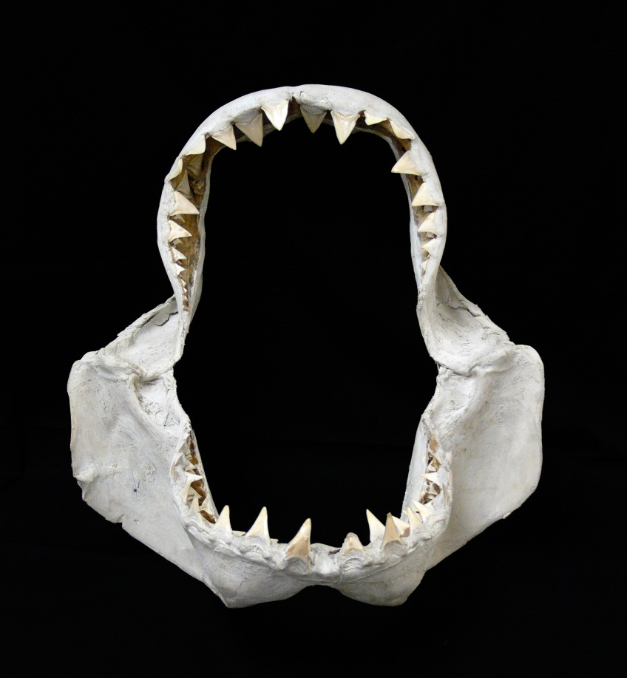
Images
Shark jaws. South Australian Maritime Museum collection

Slide 10
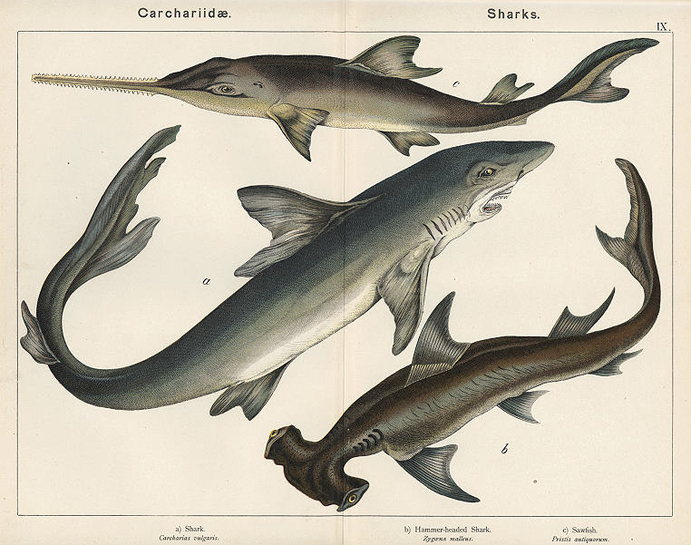
Shark, hammerhead Shark & Sawfish ] Chromo-lithograph published in Natural History of the Animal Kingdom ..., about 1885

Slide 11
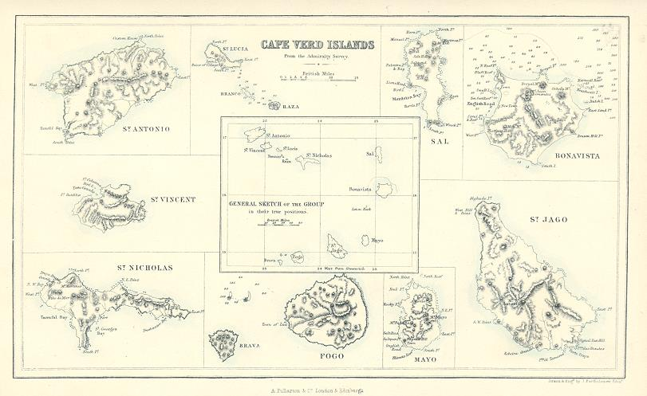
"Cape Verd Islands" drawn and engraved by J.Bartholomew, published by A. Fullarton & Co. in a gazetteer, about 1856

Slide 12
Glossary of Terms
Calm
Without wind.
Capt
Short for Captain.
Fore-top Sail
The top sail on a foremast
flying Fish
A family of marine fish (Exocoetidae family) consisting of some 64 species. The species’ defining feature is their wing-like pectoral fins used for gliding above the water’s surface for up to 50 metres. Flying fish live in all oceans, but are particularly prevalent in warm tropical and sub-tropical waters.
larboard
The old term for the left hand side of a ship looking forward. The right hand side is starboard. To avoid mis-hearing an order, it is now referred to as ‘port’.
Lattitude
Latitude is the distance of a point north or south of the equator as measured in degrees. The poles are at 90 degrees north and south.
Return to Journal Entries

Slide 13
Longitude
Longitude is the distance, measured in degrees, of the meridian on which a point lies to the meridian of Greenwich. On the other side of the earth to Greenwich is a point with a longitude of both 180 degrees east and 180 degrees west.
Mast head
The top of the mast
Return to Journal Entries

