Slide 1
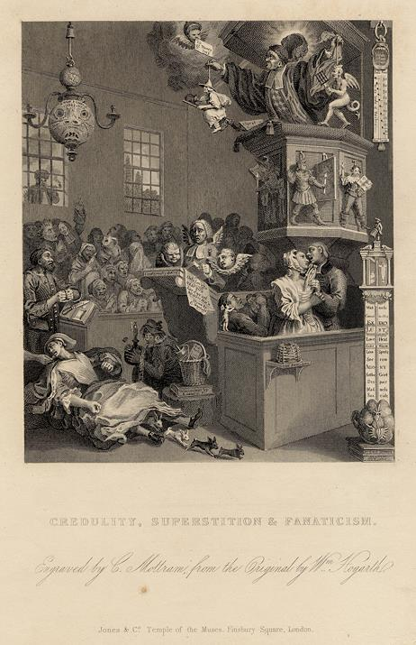
Bound for South Australia 1836 Superstitions Week 20
"Credulity, Superstition & Fanaticism" engraved after William Hogarth, published in The Works of William Hogarth, 1833.

Slide 2
Overview
Between February and July 1836 nine ships left Britain bound for the newly created province of South Australia. On-board the ships were passengers who over many long months braved the perils of the ocean, including some of the most treacherous seas in the world to begin a new life on the other side of the world.
This resource uses the stories from these nine ships as recorded by the passengers and crew in their personal journals.

Slide 3
Contents
Introduction
Inquiry Questions

Slide 4
Introduction
As we head into week 20, take the time to put yourself into the shoes of these passengers. Understandings about the wider world and journeys at sea were limited in 1836. Everyone onboard experienced a range of emotions, feelings and had different beliefs. Sailors in the 18th and 19th century were often superstitious, and although we don’t read about it this week, maybe some of the passengers onboard these vessels were also superstitious. This week we explore some of the superstitions at sea and their links to reality.

Slide 5
Inquiry Questions
How do superstitions start?
Why do some people believe superstitions and others don’t?
What are some of the superstitions of the sea?
Why are their so many superstitions about the sea?

