Slide 1
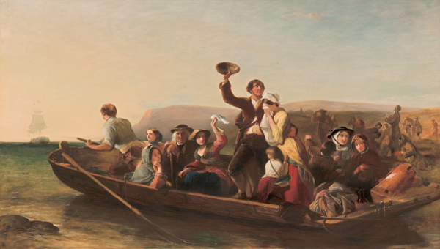
Bound for South Australia 1836 Transport week 31
Emigration - the parting day "Good Heaven! what sorrows gloom'd that parting day...", 1852

Slide 2
Overview
Between February and July 1836 nine ships left Britain bound for the newly created province of South Australia. On-board the ships were passengers who over many long months braved the perils of the ocean, including some of the most treacherous seas in the world to begin a new life on the other side of the world.
This resource uses the stories from these nine ships as recorded by the passengers and crew in their personal journals.

Slide 3
Contents
Introduction
Journal entries
Inquiry Questions
Relevant images
Glossary of terms

Slide 4
Introduction
This week the Africaine makes a stop at Cape Town, South Africa, a place
similar to an English township, with Robert Gouger commenting on ‘its air of
prosperity.’ This stop provides the passengers with a much needed
opportunity to stretch their legs, purchase fresh produce and livestock. Mary
Thomas writes how passengers ate lunch and dinner in inns and other
lodgings, comparing the quality of food to that which was eaten onboard.
Some passengers visit the sights of Simon’s Bay, including a small museum.
Mary Thomas makes reference to seeing a ‘sort of caravan, resembling a
London omnibus.’ What was she referring to in this statement? What were the
forms of transport used in 1836 and how are these the same / different to
those used today?

Slide 5
Journals from settlers in South Australia: Tuesday 20 September 1836
Samuel Stephens, who arrived in South Australia on board the Duke of York
wrote:
On the morning of the 20th the “Duke of York” & the “Lady Mary Pelham” sailed with a fair wind for Hobart Town – I parted as I had allways been, very friendly with them both – gave them such instructions, advice, & assistance as I was able – & to the Duke of York I fired a salute of 15 guns in ½ minute time – (I had but one cannon, but it was worked in excellent style) She hove to to receive my salute & returned 7 guns the other ships all hoisting their Ensigns to the Company’s Flag . Her parting signal which she hoisted when at a long distance was – “Peace be with you”. I answered it from my heart & I fervently pray God’s Blessing may rest upon our Colony. Captain Martin sails for Hobart Town in a day or two & I am busy preparing for him, besides all which I am going (D.V.) to be married to morrow & have a few little arrangements to make for that Solemn Ceremony.

Slide 6
Tuesday 20 September 1836
William Light, who arrived in South Australia on board the Rapid wrote:
20 September-Out surveying, and walked up the valley; running in a south-easterly direction, between very high hills. I was enchanted with this spot, it put me in mind of some of the orchards in Devonshire, and I found it plentifully supplied with fresh water. From this valley we ascended the hills, crossed over to the seacoast, and returned to our tents; the whole distance fine soil.

Slide 7
Journals from passengers at sea: Wednesday 21 September 1836
Mary Thomas, on board the Africaine wrote:
SEPTEMBER 21.-This day, Wednesday, about noon, we anchored in Simon’s Bay. A gentleman and lady in the cabin of the name of Hallett, with their family of three children and a servant, joined us in a boat, as they preferred going on shore with us rather than with the cabin party, on account of their family. Some black natives came alongside, and we engaged one of their boats. When we reached shallow water, there being no jetty, we were carried on shore in the arms of the men, to our no small amusement, and my daughter Mary was the first of our party to set foot on Africa.
There is a small town here, as they call it, which consisted entirely of one street, or, rather, of one row of houses at the base of tremendous hills and facing the water. The whole much resembled a newly-founded watering-place in England. The inhabitants were chiefly English, with some Dutch,

Slide 8
but we saw a great many of the native Africans, quite black, with woolly hair. They took much notice of us, and seemed to be well a ware that we had just arrived from England.
A sort of caravan, resembling a London omnibus, drawn by six horses and driven by a Malay with a tremendously long whip, brought the captain and party from Cape Town. I heard one gentleman say that he rode in one drawn by fourteen horses, but they are invariably small, and would bear no comparison with those of England. We likewise saw a light wagon, to which were attached eighteen bullocks.

Slide 9
Inquiry Questions
What forms of transport were used in England in 1836?
What types of transport were used around the world in 1836?
How have forms of transport changed over time?
How have changes in transport influenced the way people live?

Slide 10
Images
South Africa, Cape Town, 1837. Published in Meyer's Universum .

Slide 11
Glossary of Terms
(D.V.)
Deo Volente – God Willing
Ensign
A flag or standard, especially a military or naval one, indicating nationality. A national flag.
Hove to
To ‘heave to’ is to reduce a ship’s sails and adjust them so they counteract each other and stop the ship making progress. It is a safety measure used to deal with strong winds.
Return to Journal Entries

