Slide 1
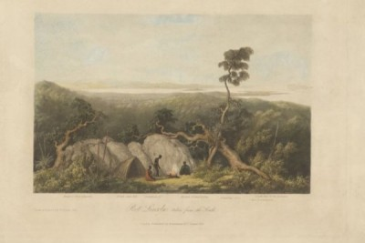
Bound for South Australia 1836 Aboriginal Perspectives Week 34
'Port Lincoln, taken from the south'. By William Westel, published 1835. Image courtesy of the National Library of Australia. nla.pic-an7832573.

Slide 2
Overview
Between February and July 1836 nine ships left Britain bound for the newly created province of South Australia. On-board the ships were passengers who over many long months braved the perils of the ocean, including some of the most treacherous seas in the world to begin a new life on the other side of the world.
This resource uses the stories from these nine ships as recorded by the passengers and crew in their personal journals.

Slide 3
Contents
Introduction
Journal entries
Inquiry Questions
Relevant images
Glossary of terms

Slide 4
Introduction
This week Colonel Light and his crew continue to search for sources of fresh
water. They are heading south looking for a river that an Aboriginal woman
has told them about. This week we will think about this story from an
Aboriginal perspective. We have been following the journeys of our nine ships
as they make their way from England to establish the province of South
Australia but what did this mean for the Aboriginal people who were already
living there? How did these people feel when the ships arrived and how did
the events that followed affect them?
Language Warning: Please note that these sources contain language which is
today considered offensive. It has been retained as it is part of the historical
record and evidence of past attitudes.

Slide 5
Journals from settlers in South Australia: Sunday 9 October 1836
Dr John Woodforde, who arrived in South Australia on board the Rapid wrote:
Sunday, 9th October.
Claughton and I again went on shore after dinner with our guns and killed sufficient fowl with yesterday’s sport for two meals. The great scarcity of fresh provisions from which most of us have suffered more or less could alone justify our thus breaking the Sabbath and I feel confident that neither of us would have done it for mere pleasure. We had expended all our ammunition and were returning towards the ship with empty guns when we found ourselves close upon five native huts which as we had no means of defence created a little alarm. It turned, however, that they were vacant and we resumed our journey unmolested but at a rather quicker pace than we had hitherto walked…

Slide 6
Monday 10 October 1836
William Light, who arrived in South Australia on board the Rapid wrote:
…we proceeded down the coast in search of the river the native woman had mentioned. At half past one p.m. hove to abreast of the river, and sent Mr Pullen in the gig to examine the entrance. At ten past two he returned, and reported his seeing a large river for some distance, but the bar of sand having such a surf over it that he was nearly upset. Again disappointed in my hopes of finding Jones’s harbour, I now felt fully convinced that no such thing could exist on this coast, at least as described by him. Captain Jones’s account says:
There are several other streams of fine water all along the eastern side of the Gulf St. Vincent. Sturt River is always open to the sea, but the others are closed by a bar of sand during the summer, through which the water filters. The inlet (mis-called by Sturt Sixteen-mile

Slide 7
Creek) is a stream of fresh water, and is much deeper and wider than the rest. About fifteen or twenty miles north of this river, he discovered a fine harbour, sheltered by an island at its entrance; the southern passage through which he entered is about one mile wide, with three and a half to four fathoms water; he anchored here in three and a half fathoms , and remained a day and a night. He did not land on the main, but was on shore on the island, which is about three miles in circumference; it is sandy, but there is an abundance of fresh water on it, as well as some streams running into the harbour from the main land…

Slide 8
Wednesday 12 October 1836
Dr John Woodforde, who arrived in South Australia on board the Rapid wrote:
…The natives we left in care of the garden have proved honest and are here to welcome our return and claim their reward. Our garden is looking well the seeds having nearly all come up.

Slide 9
Thursday 13 October 1836
Dr John Woodforde, who arrived in South Australia on board the Rapid wrote:
Thursday, 13th October.
The gale increased last night and blew with such violence that we were in momentary expectation of having our tent blown away. Jacob and I were the only two Officers on shore and in the night the carpenter and one of the labourers broached the rum cask and got dreadfully drunk. The latter was nearly dead this morning when I drew him out of the sand in which he was nearly buried and to make matters worse the tide rose so much higher than usual in the night that it floated our two boats that had been hauled up above high water mark. A box of carpenter’s tools was washed out of the surveying boat and nearly all of them are lost. Last night was the first I have slept on shore since we left England. A more uncomfortable one I never passed and it would not require many such to make me wish myself on board again. The Brig has ridden out the gale bravely which proves that the anchorage is good. The weather moderated about noon

Slide 10
and at 4 p.m. the Captain and Lady with Pullen and party joined us and all things are going on smoothly. I sent two of our natives to hunt with our dogs and they have captured a fine kangaroo which will be sufficient to feed all hands for four days.

Slide 11
Friday 14 October 1836
Dr John Woodforde, who arrived in South Australia on board the Rapid wrote:
Friday, 14th October.
We have been busy all day putting our tents to rights and have just returned from our native’s fire where they entertained us with their native dance called by them “Corroborey”. It is chiefly characterized by feats of activity and violent contortions of muscle having nothing of grace in its composition. They dance it to a very monotonous harsh kind of vocal music, constantly repeating the same words. After the dance was over I played them an air on the flute. They seemed very much pleased but did not evince any great surprise.

Slide 12
Friday 14 October 1836
William Pullen, who arrived in South Australia on board the Rapid wrote:
Thursday 14th Visited by the Natives dist-
-ributed amongst them a few red jackets &
trousers old ordnance stores which we were furn-
-ished with for that purpose, they were very
much pleased by them.

Slide 13
Inquiry Questions
Colonel Light refers to several encounters with Aboriginal people. What evidence is there in his notes to show how the Aboriginal people reacted to these encounters?
What evidence is there that Colonel Light is able to learn a lot about South Australia's landscape and environment through the knowledge, skills and lifestyles of the Aboriginal people?
We have looked at the high level of importance Colonel Light placed on access to fresh water when selecting a site for the colony. What evidence is there that water also had a significant influence on where the Aboriginal people chose to live?
Where in South Australia were Aboriginal people living at this time? Why were these places chosen by the Aboriginal people and how did the changing seasons and environment influence the way these people lived?
Colonel Light refers to several places by name including Sturt Creek and Jones Harbour. Who do you think named these places and how do you think Aboriginal people would have described the same places?

Slide 14
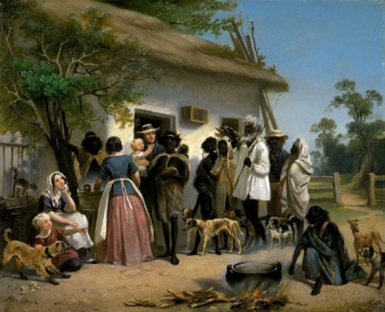
Images
A scene in South Australia. c. 1850. by Alexander Schramm. South Australian Government Grant 1982. Image courtesy of the Art Gallery of South Australia. 8212P30

Slide 15
Glossary of Terms
Corroborree
a word from the Sydney area which was by the 1830s in general use to describe a ceremony or dance performed by Australian Aboriginal people.
Brig
A sailing vessel with two square-rigged masts.
Fathom
A fathom is a measure of depth in the imperial measurement system used in the nineteenth century. One fathom is equal to six feet or 1.83 metres.
Gig
A light, narrow ship’s boat that could be rowed or sailed.
Sabbath
For most Christians the Sabbath is Sunday, the day they celebrate their religion. For other Christians and for Jewish people the Sabbath is Saturday.
Return to Journal Entries

