Slide 1
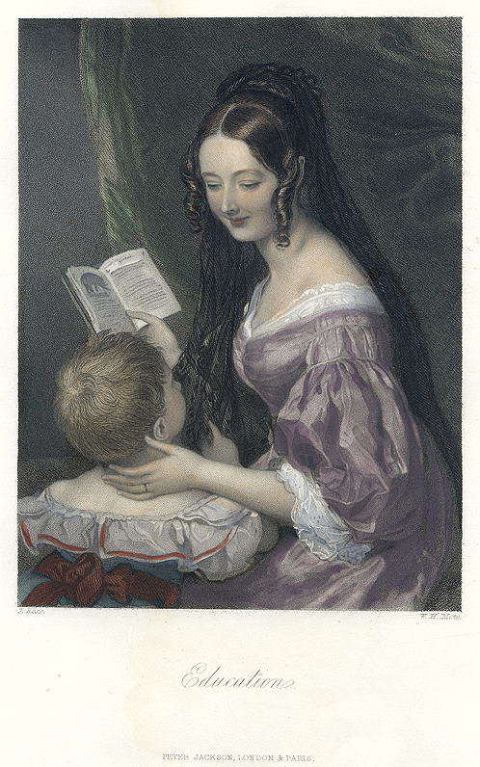
Bound for South Australia 1836 Literacy on Board Week 41
Education, Victorian genre print, 1850

Slide 2
Overview
Between February and July 1836 nine ships left Britain bound for the newly created province of South Australia. On-board the ships were passengers who over many long months braved the perils of the ocean, including some of the most treacherous seas in the world to begin a new life on the other side of the world.
This resource uses the stories from these nine ships as recorded by the passengers and crew in their personal journals.

Slide 3
Contents
Introduction
Journal entries
Inquiry Questions
Relevant images
Glossary of Terms

Slide 4
Introduction
As we have followed the journeys of our nine ships over the past 8 months we
have read many journal extracts, letters and diary entries. These primary
sources have helped us to understand what life onboard may have been like
from the perspectives of the authors. We can also use these texts to examine
the literacy skills of the captains, crew members and passengers who used
writing to record their experiences. We can also compare the way words and
language has been used in these 1836 examples and compare this to the
types of writing we do now. This week we will look closely at some primary
sources and think about the role of literacy in the lives of those onboard the
ships in our story.

Slide 5
Journals from settlers in South Australia: Sunday 27 November 1836
Robert Gouger, who arrived in South Australia on board the Africaine wrote:
Nov^{r} 27th The “Africaine”, “Rapid”, & “Cygnit” left us this morning; the first to Van Dieman’s Land for supplies, the “Rapid” up the Gulf, & the “Cygnit” to Port Lincoln to await the arrival of the Governor.

Slide 6
Sunday 27 November 1836
William Light, who arrived in South Australia on board the Rapid wrote:
27 November-Employed landing bread, and I took the opportunity of accompanying Mr Finniss as far as the third range of hills, to examine that part of the country he was then surveying; I was delighted to find the tops of the highest hills composed of excellent rich soil, and quite moist.

Slide 7
Sunday 27 November 1836
Dr John Woodforde, who arrived in South Australia on board the Rapid wrote:
My birthday. Piping hot. Most of the “Rapid’s” on shore. I accompanied Captain Light and Mr. Finnis on a walk up to the hills after dinner and finished the evening at the hut of the Surveyors with which I was invited to take tea and cake – the latter made and sent by Mrs. Lisson [Lipson?].

Slide 8
Tuesday 29 November 1836
Mary Thomas, who arrived in South Australia on board the Africaine wrote:
This evening several fires were lighted for the purpose of burning the grass, and some of them came so near to us that I began to be alarmed, for the wind drove the flames with amazing rapidity, and the grass being perfectly dry, the fires burnt with such fury as is scarcely credible.

Slide 9
Wednesday 30 November 1836
Robert Gouger, who arrived in South Australia on board the Africaine wrote:
Nov^{r} 30th I have now seen what I have so heard & read of – a country on fire! Perhaps some imaginations might realise it from the American novels; mine never could. The fire was lighted by order of M^{r} Kingston that he might with greater readiness survey to the N. & E. The wind blowing strongly the fire rapidly spread in the direction of the wind, being chiefly supported by dry grass of a most luxurious growth, but occasionally lighting upon an old gum-tree; a fallen branch of which acted as conductor to its parent stock. When this happened the fire, which at other times remained of a height nearly equable, burst up in a thick volume, & looked like a blazing town, until its branches fell away with a loud crack. The next day the fire was lighted to the S. and came up to us. I had however had a trench dug about 20 y^{ds} around me, which in case of fire, would I hoped effectively stop its march. This precautions have kept me & my enclosure safe, while all beyond is black & desert. One decided advantage has been gained by this conflagration – viz. the destruction of myriads of insects, etc.

Slide 10
Wednesday 30 November 1836
Mary Thomas, who arrived in South Australia on board the Africaine wrote:
This evening the fires again began in different directions on the farther side of the lagoon, but the wind suddenly shifting, which is frequently the case, they advanced on us so rapidly on all sides that I could not retire to rest till they were extinguished, which was not till 3 o’clock in the morning. One fire ran along on the opposite side of the lagoon, destroying everything in its way with the utmost fury. I walked down to the lagoon alone (for everyone else had retired to bed), and saw the fire ascend a tree, which made me apprehensive lest it might be communicated to the trees on our side, as they nearly met. If such had been the case the consequences might have been dreadful, as the fire in all probability would have advanced to our tents in a few minutes. Thank God, it burnt to the water’s edge and then went out.

Slide 11
Thursday 1 December 1836
Mary Thomas, who arrived in South Australia on board the Africaine wrote:
This day we saw two of the natives, a man and a boy, for the first time in this part – the mainland… I showed them several things which greatly astonished them, particularly a telescope, which they took to be a gun. They thought it would make a noise, but when I drew it out and with some difficulty induced them to look through it, for they seemed to be afraid of it, they exclaimed, “Mawny! Mawny!” which is their word for anything wonderful. But a lucifer match surprised them still more, for they could not imagine how fire could be so instantaneously produced, while they were at considerable trouble to obtain it by rubbing two sticks together. When they move from one place to another they carry lighted sticks with them, and with dry leaves and by blowing with their breath they generally succeed in soon having a good fire.
Of course, these natives did not understand English any more than we did

Slide 12
their dialect, but they pronounced our language by repeating whatever was said to them with an accuracy that was surprising and with a far superior accent to that of many Europeans not English, though they may have studied it for years. Afterwards we found that we were comparatively no strangers to them, though they were to us, for they had seen and observed our landing, but kept aloof. Subsequently they paid us several visits, but never annoyed us. On more than one occasion they proved very serviceable by helping to extinguish the fires, which sometimes came so near to us as to be extremely dangerous, beating them out with boughs from the trees or treading them out with their naked feet.
Likewise, on one occasion I could not get my fire to burn, for not having been accustomed to cook out of doors I did not understand exactly how to place the wood. Two or three of them, who were standing near, laughed at my deficiency in such useful knowledge, and, taking it to pieces, reconstructed it after their own fashion. The fire then burned brightly, verifying a saying I had often heard when a girl, that “None are so ignorant but you may learn something of them.”

Slide 13
Friday 2 December 1836
William Light, who arrived in South Australia on board the Rapid wrote:
2 December-Calm; at eight fresh breezes and fine; got under way and proceeded for Port Lincoln, at five p.m.; at eight p.m. ditto and cold; at eleven passed Althorpe Islands; at midnight hove to.

Slide 14
Friday 2 December 1836
Dr John Woodforde, who arrived in South Australia on board the Rapid wrote:
…Today I am again at work at my hut which progresses slowly, having lost the services of the native men who have taken it into their heads to leave us for a while, leaving their women behind. I enlisted three of the latter on Wednesday and found them very useful in carrying reeds for my thatch. The first dish of green pease was gathered yesterday from our garden. They relished exceedingly with a brace of wild fowl (red-bills) I killed the evening before. The temperature has been very moderate since my last notes on the thermometer.

Slide 15
Saturday 3 December 1836
William Light, who arrived in South Australia on board the Rapid wrote:
3 December-At four a.m. made sail; at eight passed Wedge Island, with moderate breezes and fine weather, but a very great swell from the southward; at noon nearly calm, off Thistle Island; at three p.m. light baffling airs, and a very unpleasant swell; at five a breeze again from the eastward, which gave us hopes of getting in before dark, as the entrance to Port Lincoln was now quite apparent, and we were drawing the land aft very fast, the bearings were Point Donington N .W., and the dangerous reef N.E. by E.; at six we were again baffled, and soon after the breeze died away; at seven we found we were going astern ; at eight the flood began to make, and we made a little progress; very light and variable winds all night.

Slide 16
Saturday 3 December 1836
John Brown, who arrived in South Australia on board the John Pirie wrote:
The Men were employ’d the beginning of this Week, in diging 3 Wells of 6 or 7 Feet each in depth but got nothing except salt Water in all of them — On Wednesday I rec^{d} orders from S^{ml} Stephens Esq^{r} C.M. to get the Stock together in readyness for departing to the Main Land, by the Brig Emma, Cap^{t} Nelson, who would take them on board the following Day or Friday at latest. We therefore on Thursday drove all the Ewes and a Ram lamb of the Sº Down breed, but which was exceed- -ingly ill, and died within an Hour after being brought Home the cause of his Death in my opinion, is from being for a length of time obliged to live upon very unwholesome Food, and brack^{h} Water, as seve- -ral of the full grown Sheep have likewise been very unwell during the last Week, and all of them are greatly falling off in condition for the Grass is so dry and burnt by the Sun that they will

Slide 17
not eat it, but prefer the green Leaves & Twigs of the samekinds of Trees & Shrubs, which are growing in the Woods about this place, and have no doubt that many of them are of a poison- -ous Nature. … We have all the Pigs, except a little Boar which has been mis- -sing for the last Fortnight, and a large black Sow that stops almost continually at North Cape _________ There has been very little Fodder at this Station for a Week past, and we are now without any whatever, so that the poor Sheep have nothing to subsist upon while confined (waiting for the Boats coming from Kingscote, to take them away) except the poor dried Grass that can be collected about the place, which is miserable fare indeed.-

Slide 18
Journals from passengers at sea: Sunday 27 November 1836
George Stevenson, on board the Buffalo wrote:
The Captain out of dignified spite to M^{r} Howard because he demonstrated to the satisfaction of every body on board that we had passed the “Slot van Capelle” before we tacked to avoid it, and with whose prerogatives therefore he is as determined to interfere as M^{r} Howard is to resist him, again deprived the Sailors of the benefit of Clergy & we had Service in the ward-room. M^{r} H’s preaching is not improving certainly, … The Sunday School is now totally neglected abandoned, & the poor children are left to shift for themselves.

Slide 19
Monday 28 November 1836
George Stevenson, on board the Buffalo wrote:
Drew up this morning the first sketch of a law for preventing unnecessary litigation & for the amicable settlement of all disputes by arbitration. I mentioned the subject to the Governor in London, & stated my opinion if we could find means to support a court of arbitration that it would be well to adopt it in Australia. He had never heard of the Danish practice; but said he liked the suggestion very much – so much indeed it appears to have taken his fancy that on my reading the act to him this forenoon, I had the pleasure of being told that he had determined to introduce the Danish law into the province long before he knew me!! He said also that he had consulted Lord Glenelg & M^{r} Stephen on the subject – both of whom approved of his intention – the latter especially was “in extasy” at his being “no lawyer”, & therefore more fitted to make laws without any regard to form or legality. Mr Stephen, I suspect, must have amused himself with

Slide 20
slyly quizzing the Governor, but I am quite certain that if either Lord Glenelg or he had ever seriously listened to him for half an hour they would have pronounced him wholly unfit for the great trust confided to his hands, The facts I record here however prove the quality & the moral honesty of the man.

Slide 21
Thursday 1 December 1836
George Stevenson, on board the Buffalo wrote:
To-day we are by reckoning 1460 miles from Cape Chatham; but we have not had a glimpse of the sun since the 27th. Poor M^{r} Fisher had another epileptic fit, the second public one since he came on board. He cut himself very severely over the right eye brow by his fall, & in fact his escape appears to have been a very narrow one. This is a most melancholy affection, & from the state of constant excitement in which he is kept by the brutality of the Governors’s conduct & proceedings it may turn out serious. I hope sincerely he will be able to weather the voyage. He passed the evening in our cabin & was a good deal more cheerful than we expected. His view & expressed opinions of the Capt. are altogether in unison with & quite as strong as our own.

Slide 22
Saturday 3 December 1836
Young Bingham Hutchinson, on board the Buffalo wrote:
Saturday, Dec^{r} 3. Fresh breezes & cloudy. Head E.S.E. Wind W.N.W. Set stud^{g} sails sails. Noon. Miles run, 149 + 13731 = 13880. Lat^{e} 39E16′ Sº. Long^{e} 91E14′ E^{t}. Water rem^{g} 55 tuns. P.M. Mod^{e} & fine. Head E.^{b} S. Wind West^{ly}. 12. Light winds.

Slide 23
Inquiry Questions
In what ways did passengers and crew need to use literacy skills onboard the ships and during the early days of establishing the colony of South Australia?
How did literacy skills vary between passengers? How can we use the primary sources to learn about the literacy skills of the authors?
Whose perspective do we learn about in this week's entries? What other perspectives are there and how might we find out about them?
How did Aboriginal people and English settlers interact and communicate without speaking the same language?
How effective are these journal entries in helping us to imagine the experiences of the authors? Which features of the writing are effective in helping us understand what the experiences were like?

Slide 24
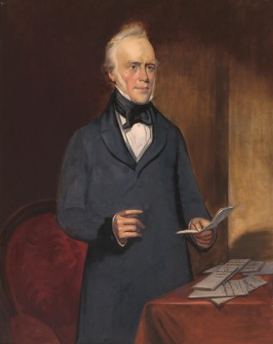
Images
The Honourable George Fife Angus, c. 1920-1935. Courtesy of the Art Gallery of South Australia

Slide 25
Glossary of Terms
aft
At or towards the stern or rear of a ship.
astern
To be any distance behind a vessel.
hove to
To ‘heave to’ is to reduce a ship’s sails and adjust them so they counteract each other and stop the ship making progress. It is a safety measure used to deal with strong winds.
Lat^{e}
Latitude is the distance of a point north or south of the equator as measured in degrees. The poles are at 90 degrees north and south.
Long^{e}
Longitude is the distance, measured in degrees, of the meridian on which a point lies to the meridian of Greenwich. On the other side of the earth to Greenwich is a point with a longitude of both 180 degrees east and 180 degrees west.
lucifer match
A Friction match – a kind of match tipped with a compound that ignites by friction.

Slide 26
studg sails
Studding sails were set outside the square sails in fine weather and with a fair wind. Their head was fastened to a short yard hoisted to the end of the upper yard and their foot extended by a boom slid out from the lower yard. They took their name, such as main topmast studding sail, from the adjacent sail.
Tacked
Ships could not sail directly into the wind, but they could sail across it at an angle. So, to move forward in the direction of the wind they set a zigzag course, sailing across the wind at alternating angles. That procedure was called tacking.

