Slide 1
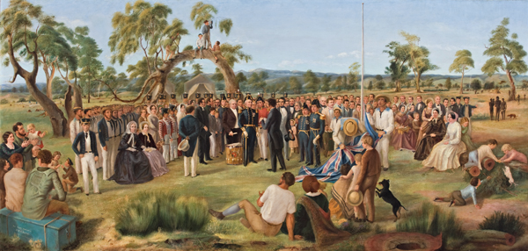
Bound for South Australia 1836 Proclamation and Celebration Week 45
The Proclamation of South Australia 1836, c. 1856-1876. Courtesy of the Art Gallery of South Australia

Slide 2
Overview
Between February and July 1836 nine ships left Britain bound for the newly created province of South Australia. On-board the ships were passengers who over many long months braved the perils of the ocean, including some of the most treacherous seas in the world to begin a new life on the other side of the world.
This resource uses the stories from these nine ships as recorded by the passengers and crew in their personal journals.

Slide 3
Contents
Introduction
Journal entries
Inquiry Questions
Relevant images
Glossary of Terms

Slide 4
Introduction
We have now reached the end of our story only to find we have arrived at the very beginning of the next story. By the end of this week all nine of our ships have arrived in South Australian waters with the Buffalo arriving in Holdfast Bay on December 28th. As soon as the Buffalo arrives, a meeting is held in Robert Gouger’s tent where a Proclamation announcement is agreed upon. The settlers then assemble around a giant gum tree while George Stevenson reads out the proclamation and the Province of South Australia is officially proclaimed. This week we will look at the Proclamation of South Australia and consider what it means to the settlers and the Aboriginal people who were already living in South Australia. Christmas day also falls this week which gives us an opportunity to think about the way people have celebrated significant days and events since 1836.

Slide 5
Journals from settlers in South Australia: Sunday 25 December 1836
Mary Thomas, who arrived in South Australia on board the Africaine wrote:
This being Christmas Day and Sunday, Divine Service was held for the first time in the rush hut of the principal surveyor, a short distance from our tents. We attended, taking our seats with us, the signal for assembling being the firing of a gun. The congregation numbered twenty-five persons, including the two gentlemen who conducted the service. The thermometer stood at 100 degrees, and most of those assembled were in the open air.
….
We kept up the old custom of Christmas as far as having a plum pudding for dinner, likewise a ham and a parrot pie, but one of our neighbours, as we afterwards found, had a large piece of roast beef, though we were not aware at the time that any fresh meat was to be had in the colony, and that, I believe, was partly salted. The fact was, when we landed at Glenelg, one of the passengers of the Africaine took charge of Captain

Slide 6
Duff’s cow and calf, and the former, which had been tied to a tree near the lagoon, got over the bank and fell in, being so much injured that it was found expedient to kill her. Thus some of the colonists were supplied with their Christmas beef.

Slide 7
Sunday 25 December 1836
Young Bingham Hutchinson, who arrived in South Australia on board the Buffalo wrote:
Light winds & fine. S.E. Working to windw^{d} between Wedge isle & Thistle isle. Performed Di- -vine Service on deck. P.M. Dº W^{r}. Wind South. At 2 Capt^{n} Lipson & family came to dine with the Governor. Light winds & fine. Working to the N.E. end of Wedge island.

Slide 8
Sunday 25 December 1836
George Stevenson, who arrived in South Australia on board the Buffalo wrote:
Christmas Day, clear, cloudless & beautiful; with the thermometer at 68 Thoroughly disgusted with the conduct of the Governor to-day. Such violence & ruffianism are without parallel, & his profane & abominable oaths have driven all but his own & M^{r} Howard’s family from the deck to seek refuge from the outrageous profanity in their own cabins. Waiting for the Cygnet to come alongside with Capt Lipson’s family to dinner. This is pushing on with a vengeance! The jaw of a remarkably large shark brought on board It measured when extended six feet four inches in circumference. The length of the animal was 19 feet. Its liver alone yielded 25 gallons of oil & the weight altogether was estimated at little less than five tons: it was taken in Nepean Bay.

Slide 9
Sunday 25 December 1836
Dr John Woodforde, who arrived in South Australia on board the Rapid wrote:
Christmas Day. Reminds us of Old England and our friends warming their knees by a rousing fire, with all other Christmas comforts. Here we are broiling under a sun nearly vertical and half of us nearly blind with Opthalmia which I hear from the Sealers who visit this Coast always prevails during the Summer months. It is very distressing and of the purulent kind. The small flies, which when living in the tents were maddening, are, I am happy to say, much less troublesome in the huts, but the large disgusting blow-fly is very active, actually depositing living maggots on the plate you are eating off and making no distinction between fresh meat and the salt ship provisions. One of our sheep, the first, was killed last night after sunset and my ration which was served out at 6 this morning altho’ carefully wrapped in a towel was actually crawling by 10 and it has taken me nearly an hour to wash it.

Slide 10
Nothing worthy of mention has occurred this last week with the exception of the days when I brave the heat and sally forth with my gun. My time is passed principally within my hut reading etc. The whale-boat left here by Captain Light which was to have been such a source of comfort, has, on the contrary, created disappointment, as we have had no success whatever among the finny tribe. Our dinner today (that is Jacob’s and mine) will consist of the above named piece of mutton, some parrots and pigeons, killed, plucked and cleaned by me and a plum pudding made by Jacob, and all I have to say is that I sincerely hope my dear friends at home are spending a Merrier Christmas than we are here. If not, I pity them.

Slide 11
Monday 26 December 1836
Mary Thomas, who arrived in South Australia on board the Africaine wrote:
This day was extremely hot. The thermometer rose to 120 degrees, the highest point we had yet seen it attain, and that in the shade, at least, in the tent, where it was generally hot, but I afterwards saw it at 150 degrees, exposed to the sun.

Slide 12
Tuesday 27 December 1836
Robert Gouger, who arrived in South Australia on board the Africaine wrote:
Sunday last was Christmas Day! What a temperature to regale on plum-pudding! nevertheless we did so! In the morning we attended prayers read by M^{r} Kingston, with a sermon on “The Birth of Christ”, but the congregation did not exceed 30 persons! Yesterday was oppressively hot: in the hut the thermometer stood at 86E – in the tent, under the inner covering 104E & under the outer covering 116E.

Slide 13
Wednesday 28 December 1836
Mary Thomas, who arrived in South Australia on board the Africaine wrote:
The following was published in The Observer, January 2, 1858, on the occasion of the colony having attained its majority. A festival was held at Glenelg on December 18, 1857, to commemorate the event:-
From the diary of Mrs. Robert Thomas, written the day after the Proclamation, December 28, 1836 :-
This was a proud and, I hope, will be a happy day for South Australia. Early in the morning it was announced that the Buffalo had arrived from Port Lincoln, accompanied by the Cygnet, which had gone thither to escort the Governor, Captain Hindmarsh, to Holdfast Bay. This made us all alive, and soon after Mr. Thomas received notice to attend at the tent of Mr. Gouger, the Colonial Secretary, where His Excellency the Governor was expected to be at 3 o’clock to read his Commission and proclaim the colony. Mr.

Slide 14
Thomas then went to the Company’s store and soon returned with a request that he would procure a ham, as Mr. Gilbert was not provided with one, which was done, and a fine Hampshire ham was dressed for the occasion. It was also requested that we would prepare ourselves to meet the procession, as all who could were expected to attend. We went accordingly, and found assembled the largest company we had yet seen in the colony, probably two hundred persons.
The Governor’s Private Secretary read the Proclamation under a huge gumtree, a flag was hoisted, a party of marines from the Buffalo fired a feu-de-joie, and loud hurrahs succeeded. A cold collation, of which we partook, followed in the open air. The Governor was very affable, shaking hands with the colonists and congratulating them on having such a fine country. After the repast he mounted on a chair and gave the first toast, “The King,” which was received with three times three, and followed by the National Anthem, led by Mr. Gilles. The old royal appellation of “George ” was so natural to Englishmen, after four successive reigns of Kings of that name, that it was forgotten at the moment that a “William” was now on the throne, and the first line was sung as formerly, “God save

Slide 15
moment that a “William” was now on the throne, and the first line was sung as formerly, “God save great George, our King,” which excited a smile. Yet I believe that William the Fourth has not more loyal subjects throughout his wide dominions than those who were there assembled to welcome the arrival of the first Governor of South Australia. The health of His Excellency was then proposed and drunk with loud and universal cheering, followed by “Rule, Britannia.” Then “Mrs. Hindmarsh and the Ladies ” was proposed by Mr. Gilbert, and also received great applause, as did several other toasts.
The Governor then gave the following:- “May the present unanimity continue as long as South Australia exists,” which made the plain ring with acclamations. At about 5 o’clock His Excellency and lady departed to the ship, and some officers and others followed in another boat. They all seemed highly delighted with our village, as I may call it, consisting now of about forty tents and huts, though scattered about without any regularity. Everyone fixed his present abode wherever he wished, knowing it would not be of long duration. We took coffee in Mr. Kingston’s hut, and returned home about 7 o’clock.
The evening, as well as the day and the preceding one, was very hot, and

Slide 16
the night continued so, insomuch that it was impossible to sleep, the thermometer having been sometimes upwards of 100 degrees in the tent. It seemed as if some of the colonists did not even go to bed, for we heard singing and shouting from different parties at intervals till long after daylight. Here I may remark that from the exceeding stillness of the night, except when the wind disturbed the trees near us, we could distinctly hear almost every sound that occurred, though at a considerable distance.

Slide 17
Wednesday 28 December 1836
Young Bingham Hutchinson, who arrived in South Australia on board the Buffalo wrote:
Mod^{e} & fine. 7. Sent a boat on shore to the settlement in Holdfast bay. 10. Anchor’d in Holdfast bay in 7 f^{ms} . Noon. Light winds & fine. P.M. Dº W^{r}. At 2 His Excellency Governor Hindmarsh accompanied by the Colonial & Naval Officers land- -ed. The Ship was dressed in all her colours, & fired a royal salute, & His Majesty’s commission to the Governor having been read, a feu-de-joie was fired by the Marine guard of Honour, when the English Ensign of S^{t} George was hoisted. The Governor’s Proclamation was then read, after which His Majesty’s & His Excellency’s healths were drunk with great enthusiasm. The sailors then began

Slide 18
to get pretty drunk, so that we had great dif- -iculty to get on board, many staying behind. The natives set fire to the woods, which burnt grandly.

Slide 19
Wednesday 28 December 1836
George Stevenson, who arrived in South Australia on board the Buffalo wrote:
The wind continued favorable during the night, & this morning we came to an anchor in Holdfast Bay, lying due west of Mount Lofty & now about thirteen miles to the southward of the intended harbour. M^{r} Gouger came on board with a M^{r} Kingston one of the surveyors & gladdened us with the intelligence of splendid land, plenty of fresh water, & the prospect of an excellent location…. It was determined to go ashore to day & read the Governor’s Commission &c, & preparations to land were made. At ½ past one we left the Buffalo – the Governor, Fisher, myself & our families in one boat, the Treasurer, Chaplain & others in a second, & about 20 marines in a third besides the officers of the ship. The Council met in Gouger’s tent, where the orders in Council & Commission were read & the oaths to the Governor & members of Council were administered. The Commission was afterwards read by me to the settlers of whom about 200 were present. A royal salute to the British Flag was fired & a feu-de-joie by the

Slide 20
marines. Afterwards the Buffalo saluted the Governor with 15 guns. A cold collation was prepared in the open air of which the party partook; & all might have gone off very well had not our Treasurer got brutishly drunk and conducted himself in his usual disgraceful fashion towards every lady & gentleman with whom he came in contact. We were all delighted with the aspect of the country & the rich soil of Holdfast Plains: Mount Lofty & the hills before us are wooded to the very summits 1500 feet at least above the level of the sea. On the plains there are numerous splendid trees of the eucalyptus species: the Banksia rosa marinafolia was in great beauty. We found the pea, butter cup, the camomile daisy, and geranium, the flax plant, the kangaroo grass in great abundance. The parrots & parroquets were very numerous. In a short walk we started several covies of quail, & from a specimen shot there does not appear any difference between it & the European variety. Nothing in fact can be richer than the soil: I have seen the Pickaway plains of Ohio & traversed the Prairies of Illinois & Indiana, but the best of them are not to be compared to the richness of Holdfast Plains . . .

Slide 21
Wednesday 28 December 1836
Robert Gouger, who arrived in South Australia on board the Africaine wrote:
This morning, on going as usual to let out my goats, I saw 2 large Ships entering the Bay, which proved to be the “Buffalo” (bringing the Governor & other officers) & the “Cygnet” from Port Lincoln. Before 8 o’cl^{k} a messenger arrived at my tent requiring my attendance on board. I found His Excellency & the whole party in good health & spirits, & full of hope & ardour to commence their Colonial career. After some consultation it was decided that the Governor & emigrants should land here at once, & that in the course of the day, the necessary oaths should be taken & the Governor’s commission read. At 3 o’clk the Marines from the “Buffalo” were drawn up in a line, & the whole of the Colonists assembled in front of my tent. Before however reading the commission in public, I took the necessary oaths of office, & as senior Member of Council present, I administered to the Governor the oaths of office. We then held a Council

Slide 22
in my tent for the purpose of agreeing upon a Proclamation requiring all to obey the laws & declaring the Aborigines to have equal rights & an equal claim upon the protection of the Government with the white Colonists. The Commission was then read in public, a “feu-de-joie” was fired by the Marines, the white ensign hoisted, & a salute fired by the ships. The Proclamation having been read, the meeting adjourned to M^{r} Kingston’s tent, where a cold dinner was provided for such as chose to partake of it, & the festivities were kept up unto a late hour. Rapidly as my heart beat on this occasion – an occasion to which, during the years I had devoted to the prosecution of the enterprise, I sometimes dared to anticipate and rejoice in; I was not suffered long to bestow even one thought upon it.

Slide 23
Wednesday 28 December 1836
Dr John Woodforde, who arrived in South Australia on board the Rapid wrote:
Our conjectures with regard to the ship yesterday were strengthened this morning by hearing distant guns, as of a salute given and returned in the direction of the settlement, and we have come to the conclusion that the Governor is safely arrived and that his salute was returned by the land battery brought by the “Tam O’ Shanter”. I have been shooting all day and have killed nearly five brace of quails which is considered as excellent sport, but in my opinion the best of the sport is in the eating. Our life here is exceedingly monotonous and uninteresting as we are completely debarred from news. We are all very anxious to remove to Holdfast Bay.

Slide 24
Thursday 29 December 1836
Robert Gouger, who arrived in South Australia on board the Africaine wrote:
The commission had hardly left my tent yesterday when the doctor was called in attendance upon my wife, who this morning at 6 o’cl^{k} gave the New Province a son! I say “gave the Province a son” for he is claimed by the Governor as his God-son, as being the first child born in the Colony, after the Establishment of the Government.

Slide 25
Friday 30 December 1836
Robert Gouger, who arrived in South Australia on board the Africaine wrote:
Wife & child both going on well. — A meeting of the legislature was held in my tent, at which two acts were passed – one establishing Courts of general & petty sessions, & another fixing the qualification of Jurors. Some Magistrates were also appointed at the meeting.

Slide 26
Inquiry Questions
Who was involved in drawing up the Proclamation for South Australia?
What was the purpose of the Proclamation? What was it to be used for?
What agreements are made in the Proclamation? What does it mean?
What is the significance of Proclamation day? Consider a range of perspectives.

Slide 27
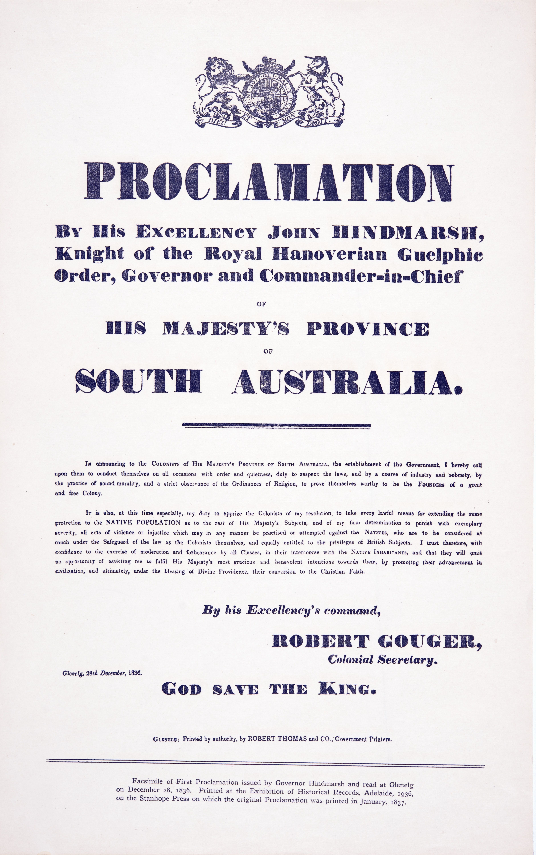
Images

Slide 28
"Plums - 1.Monarch, 2.Transparent Gage, 3.Golden Transparent Gage" bold chromolithographic fruit print published in Thompson's Gardener's Assistant, about 1895. Ref F864

Slide 29
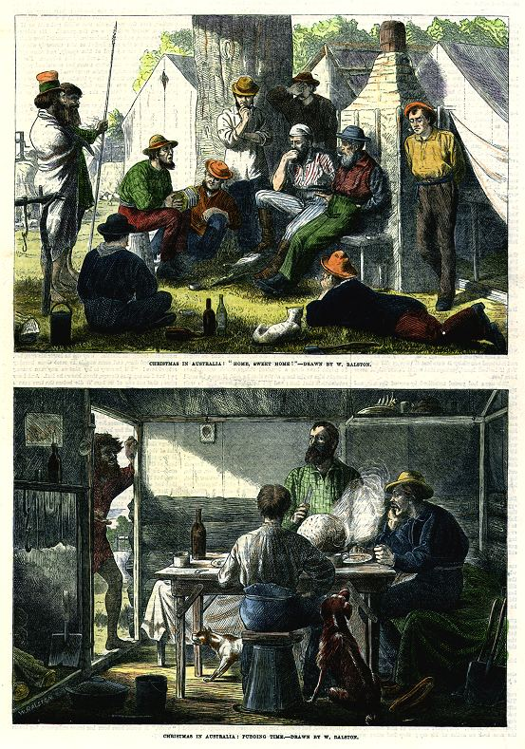
" Christmas in Australia ... " pair of wood engravings published in The Illustrated London News, December, 1870. Ref D5662

Slide 30
Glossary of Terms
feu-de-joie
A rifle salute. In French means “fire of joy”
Opthalmia
An inflammation of the eye.

